Slide 1
Why the youths choose radicaliSation or migration
Socio-economic challenges ahead the young generation in the Euro-Med region.

Slide 2
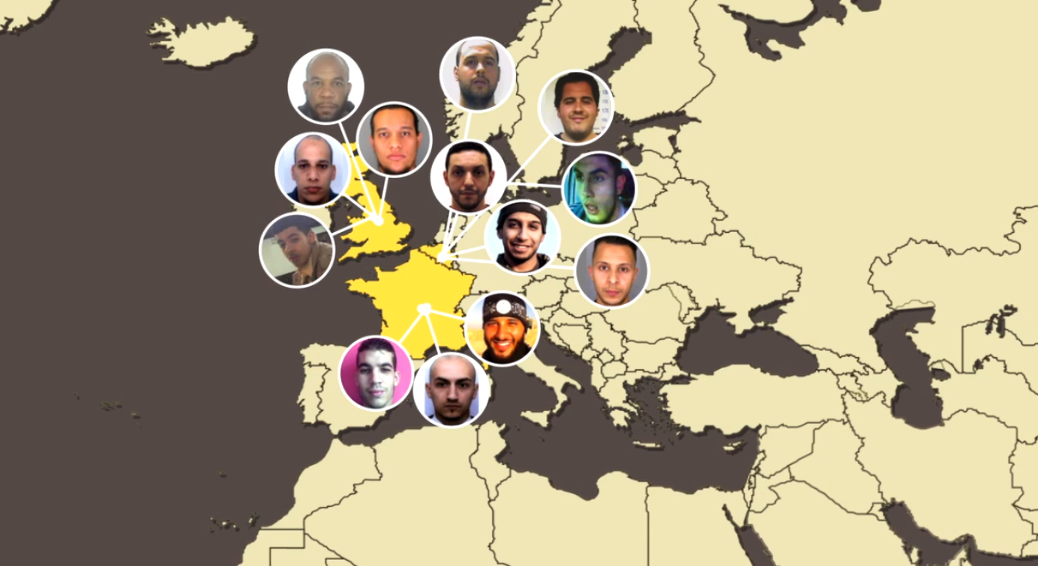

Slide 3
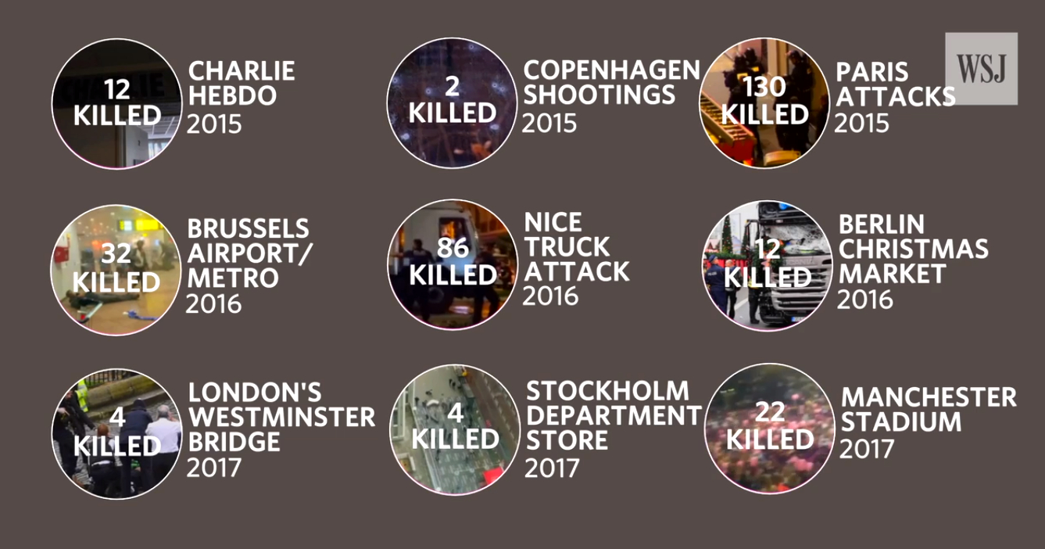

Slide 4
Radicalisation
WHY it’s important to deal with radicalised and extremists
WHO is vulnerable to radicalisation
HOW MANY people are concerned

Slide 5
1. They kill and destroy (easy part)
2. Create territories of intolerance, violence, lack of law&order, reject basic values (problem)
3. Stigmatise ISLAM and MUSLIMS in general - as religion and community (danger)
WHY

Slide 6
- Young people and people from lower income and minority groups
- Distrust institutions and see a identity conflict (between being British, German, French, Bulgarian… and their own cultural identity)
- Perceive discrimination, experience racial or religious harassment, and have a negative view of policing
WHO
Groups particularly vulnerable to radicalisation:

Slide 7


"The radicals are estimated to be between 15% to 25%, according to all intelligence services around the world.
You're looking at 180 million to 300 million people dedicated to the destruction of Western civilization.“
Brigitte Gabriel
ACT! for America's president and founder
HOW MANY

Slide 8
HOW MANY (at risk)
1% in Western Europe
125 000 (Germany, France, and the United Kingdom)
325 000 (Europe)
Less than 10 000 went to Syria and Iraq

Slide 9
Definitions
Radicalisation
Extremism
Violent extremism
Terrorism
Jihad

Slide 10
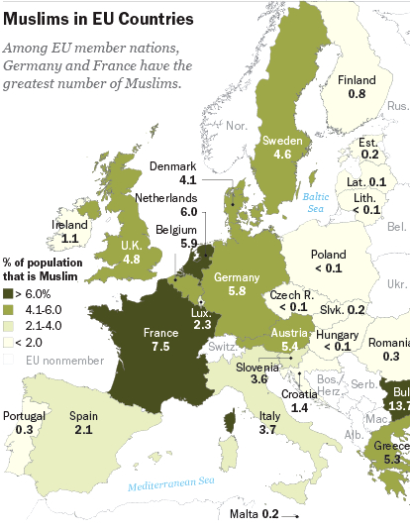
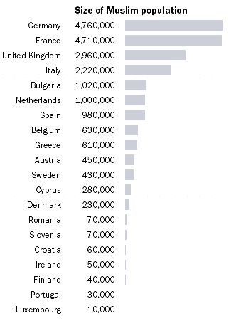
Muslims IN EUROPE
17-18 mln. (2010)
13 mln. Muslim immigrants
1990 - 4%
2010 - 6%
2030 - 8%
(14 mln. Russia - the largest
on the continent, 10%)

Slide 11
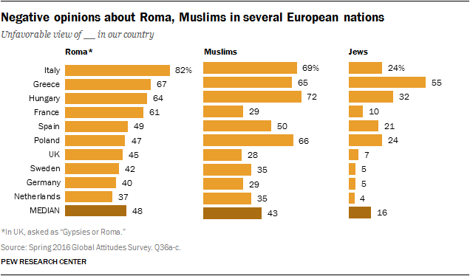
MINORITIES

Slide 12
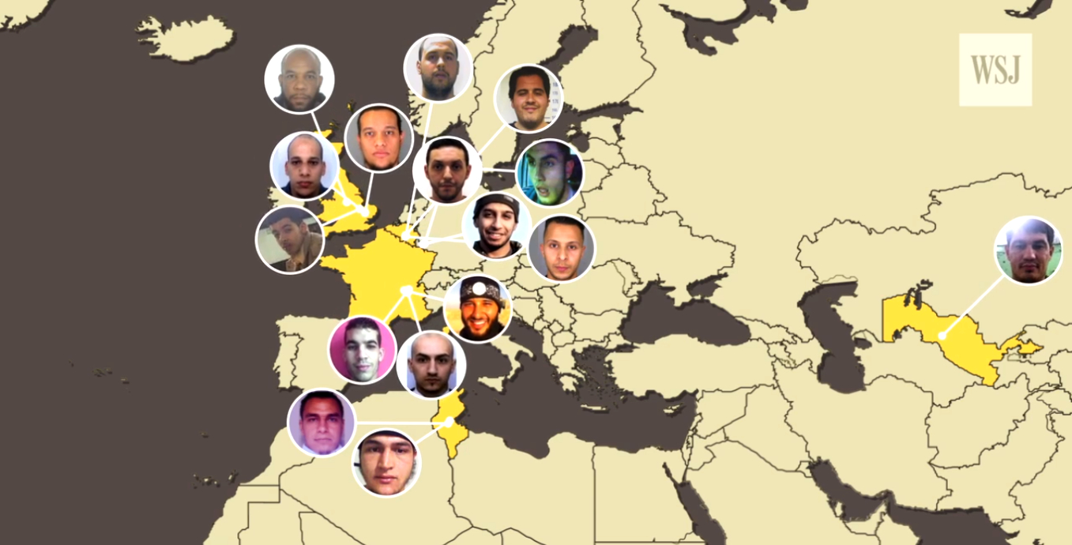
Definitions

Slide 13
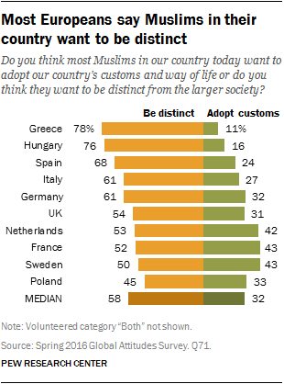
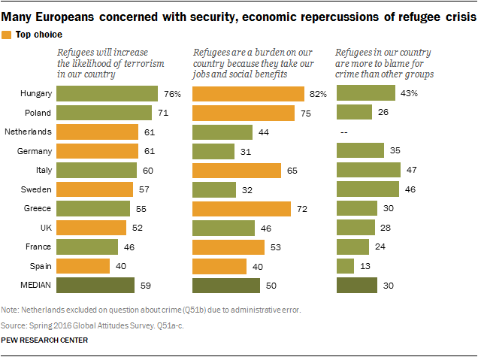
DISTINCT MUSLIMS

Slide 14
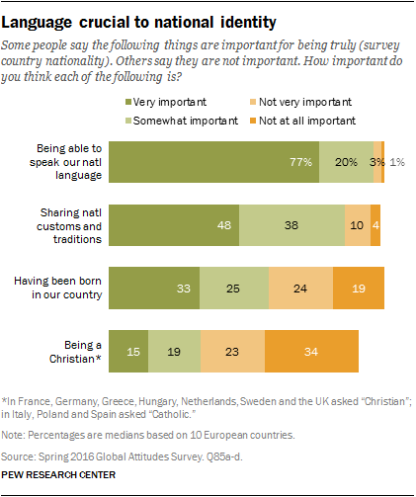
national identity
Language, customs and tradition
97% - language is fundamental
86% - sharing national customs and traditions
58% - need to be born in a given country
34% - religion is important (!)

Slide 15
Muslims are younger
than other Europeans
Muslims - 32 years old (median)
Europeans - 40 years old
European Christians - 42 years old

Slide 16
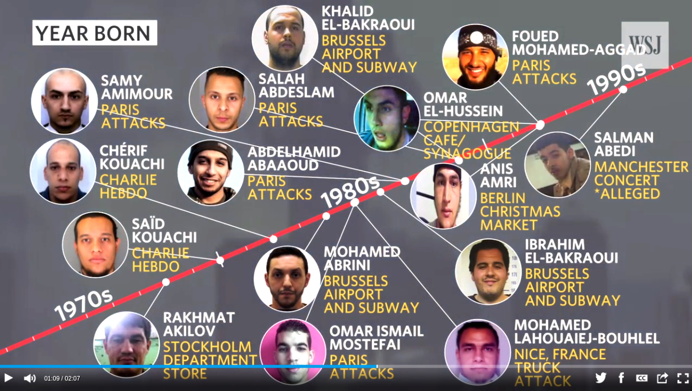

Slide 17
The majority of radicalised are 13 - 25 years old
Two-thirds of all terrorist offences were committed by those under 30, but the age of offenders ranged from 16 to 48.
Education levels and economic status vary.
Arguments about social exclusion were not entirely convincing
Perception of foreign policy as an attack or a targeting or a singling out or a discriminatory attitude towards Muslims and Islam.

Slide 18
Drivers & routes
into Islamist radicalisation
Where
does radicalisation
take place?
Identity
Integration
Ideology
Personal
vulnerabilities
Religious institutions
Prisons
Internet
Family, universities,
street, abroad...

Slide 19
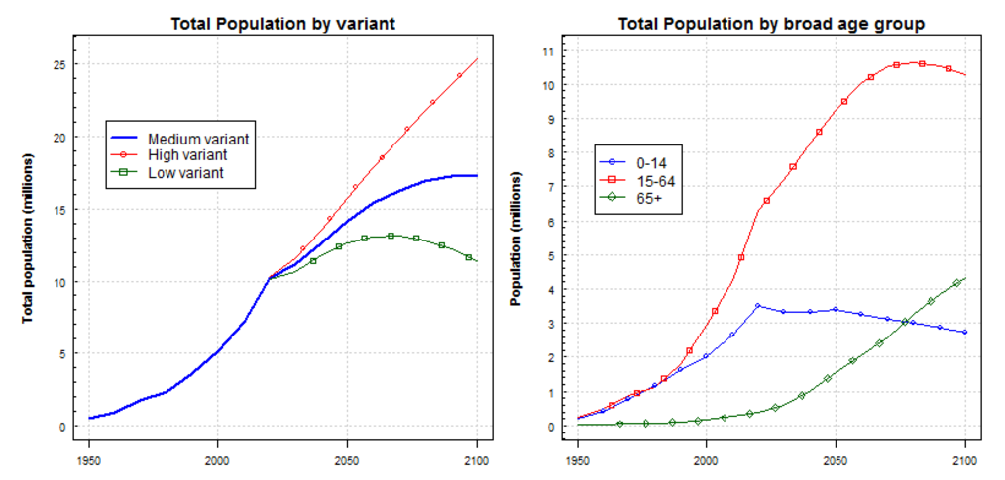
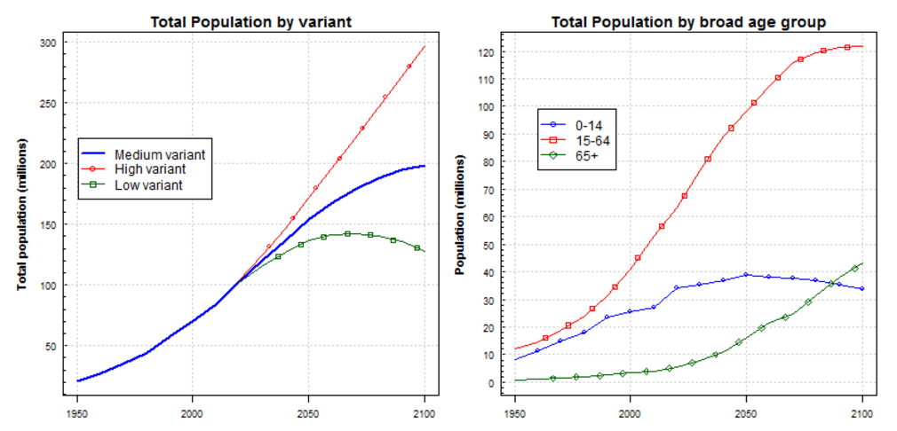
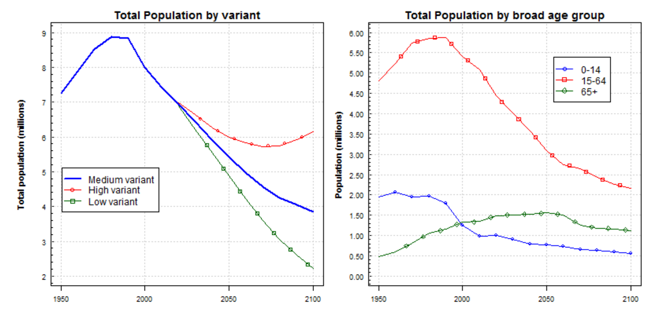
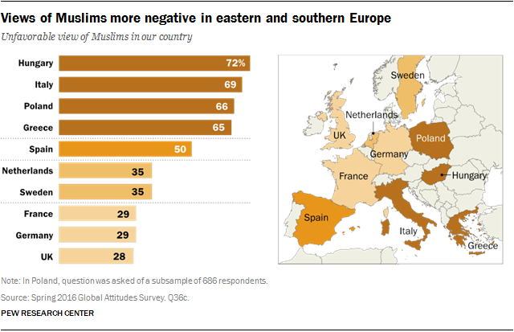
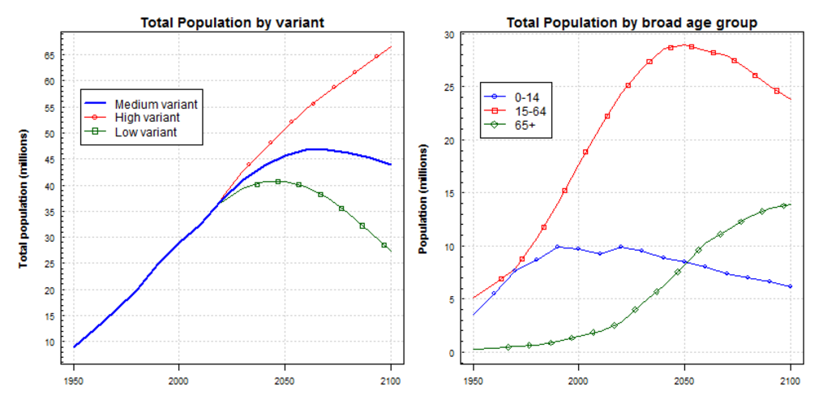
THE FUTURE
World Population Prospects 2017

Slide 20
EGYPT

Slide 21
MOROCCO

Slide 22
JORDAN

Slide 23
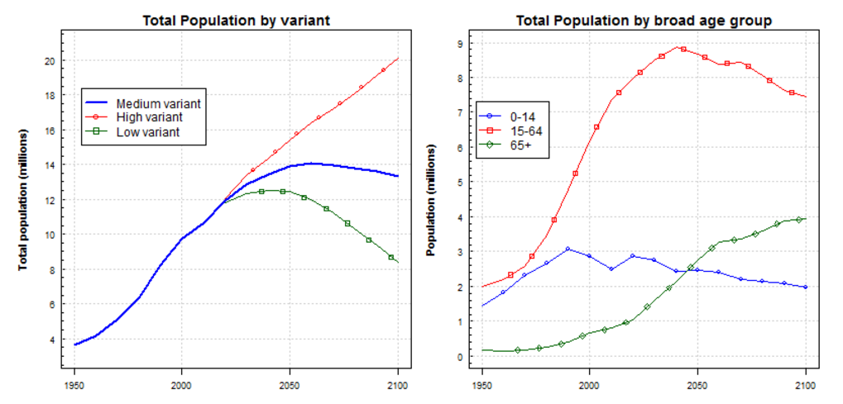
Tunisia

Slide 24
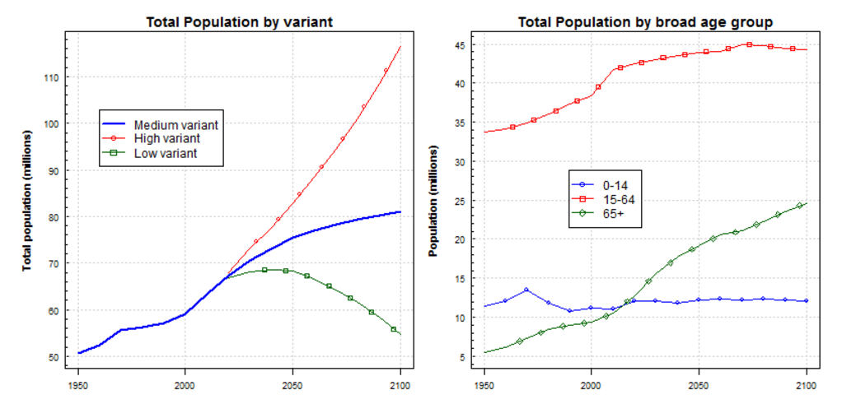
UNITED KINGDOM

Slide 25
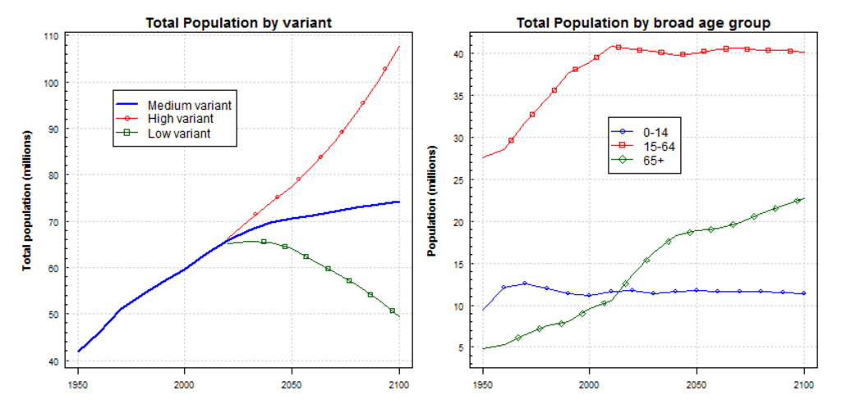
FRANCE

Slide 26
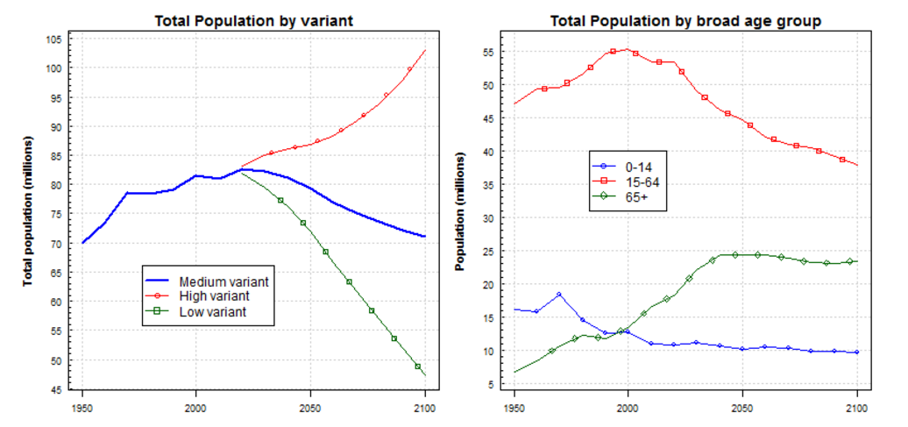
GERMANY

Slide 27
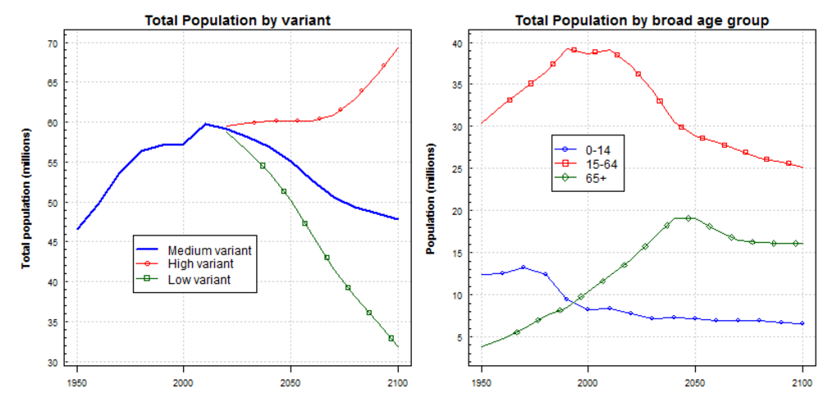
ITALY

Slide 28
BULGARIA

Slide 29
CONCLUSION
Radicalisation, violent extremism and terrorism
are symptoms of larger problems in society.
Diagnosis of these by-products is direction we must invest.
Fair answer to the questions like:
- Who is in and who is out?
- Who are the Haves and the Have Nots?
- Who is educated and does this REALLY maters to be successful?
If we don’t have answers extreme preachers will fill the gap

Slide 30
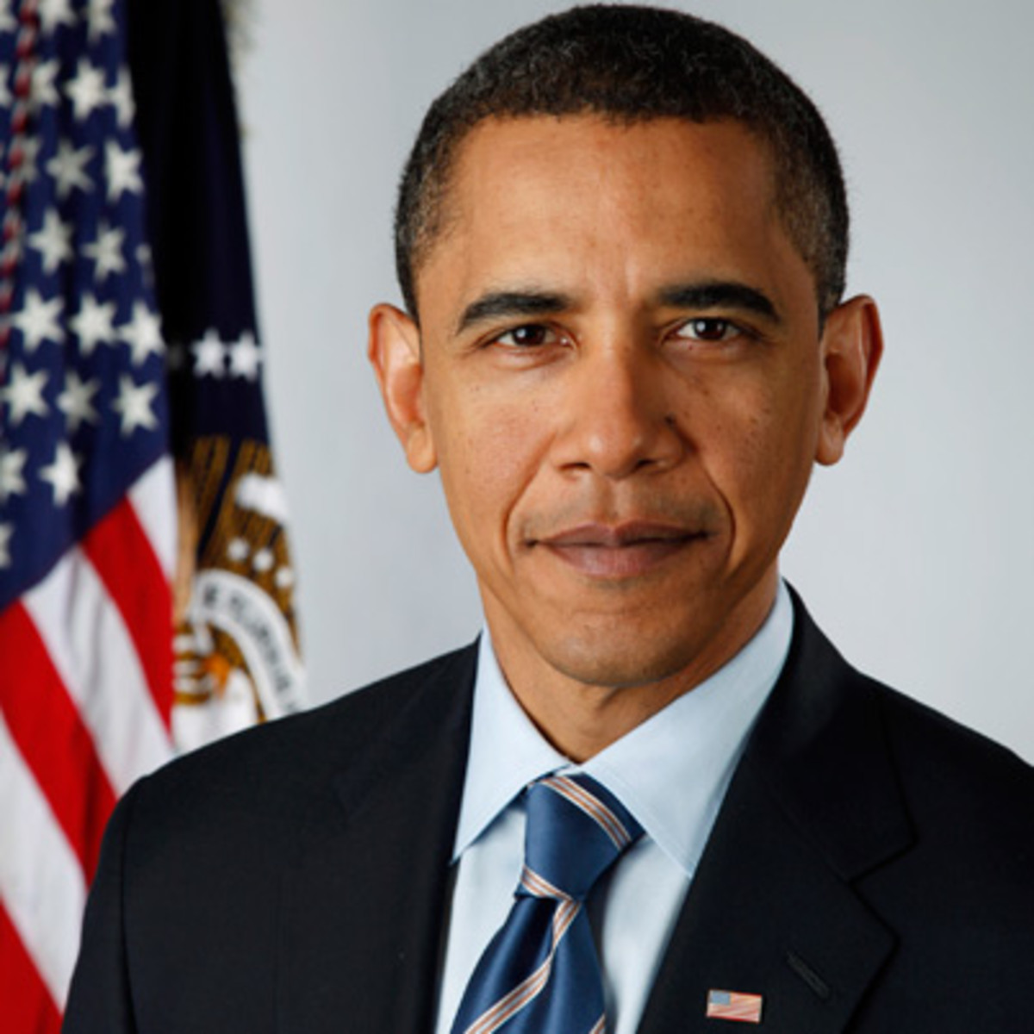
“If you are strong in your own faith
then you should not be worried about someone else’s faith.”
Barack Obama

Slide 31
THANK YOU!
MERCI!
شكرا!

